Slide 1

NETFLIX PROJECT
USING
TABLEAU
VISUALIZATION

Slide 2
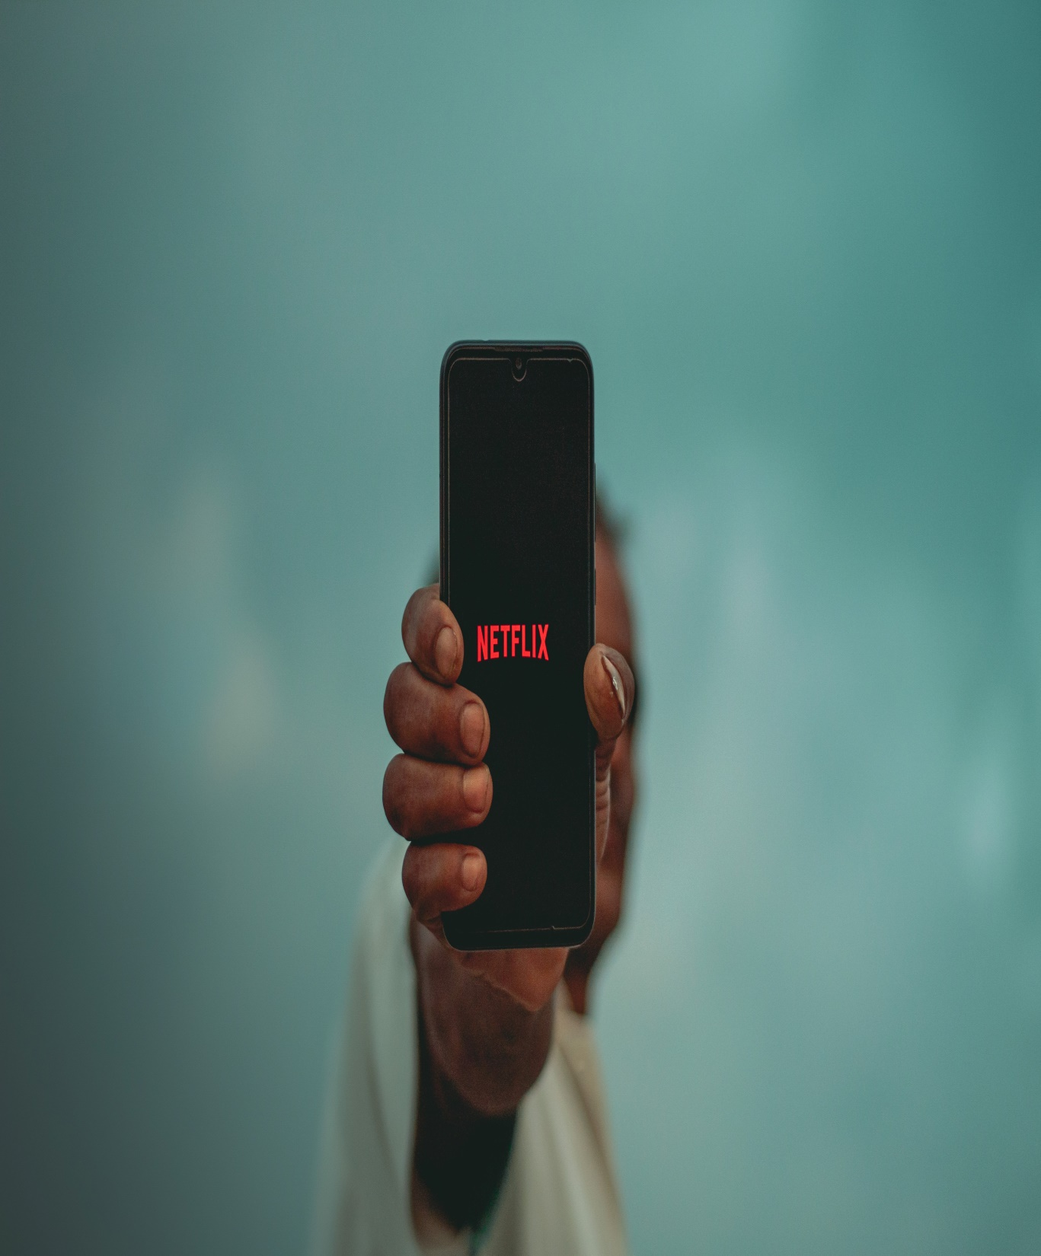
OVERVIEW
This project is Based on Netflix Data, Some valuable insights.
From this Data-set the fields which are used are as follows:-
Title
Director
Cast
Country
Release year
IMBD Rating
Subscribers.
Revenue,

Slide 3

Objectives
Top Countries With Most Netflix Content With Movies And TV Shows.
Top Directors with Most movies & TV Shows
Number of Movies & TV Shows as per the Year
Top Actors Movies & TV shows
Count of TV Shows and Movies
Total REVENUE till 2022
SUBSCRIBERS till 2022
IMBD SCORE As Per the Actors.
Top Most Used Languages In Netflix.

Slide 4
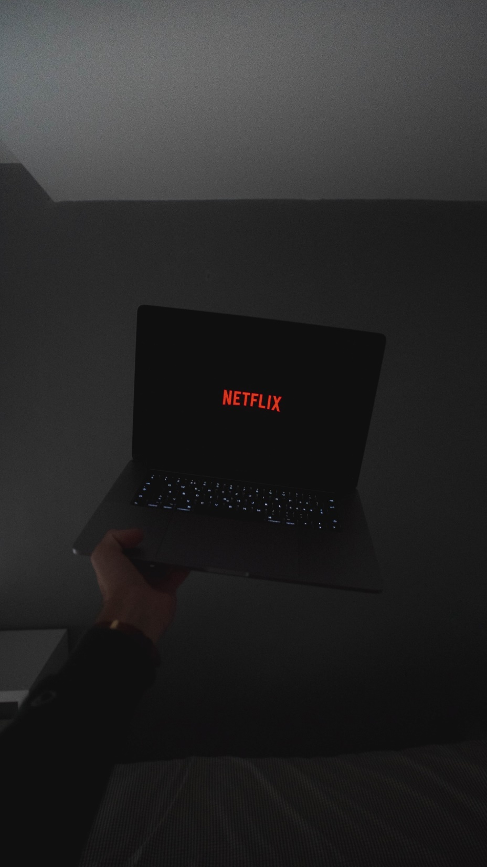
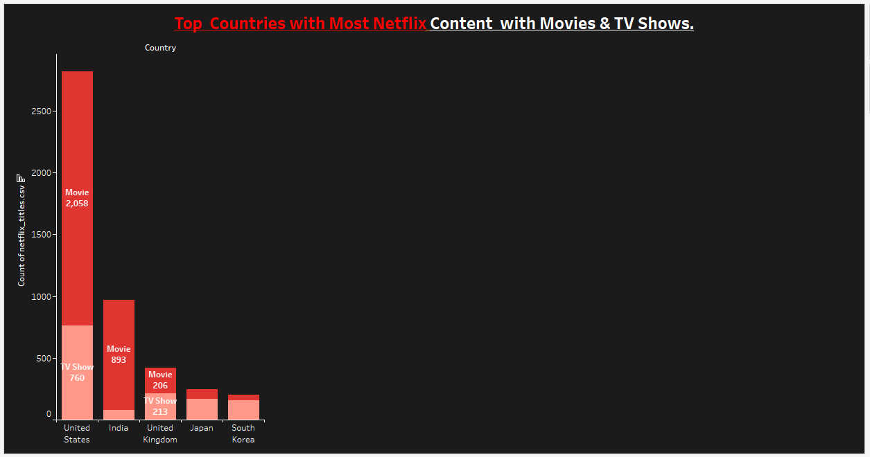
Top Countries with Most Netflix Content with Movies & TV Shows.
CONCLUSION: These are the some top countries which shows most Netflix
Content. United State ,India ,UK, Japan and South Korea.

Slide 5

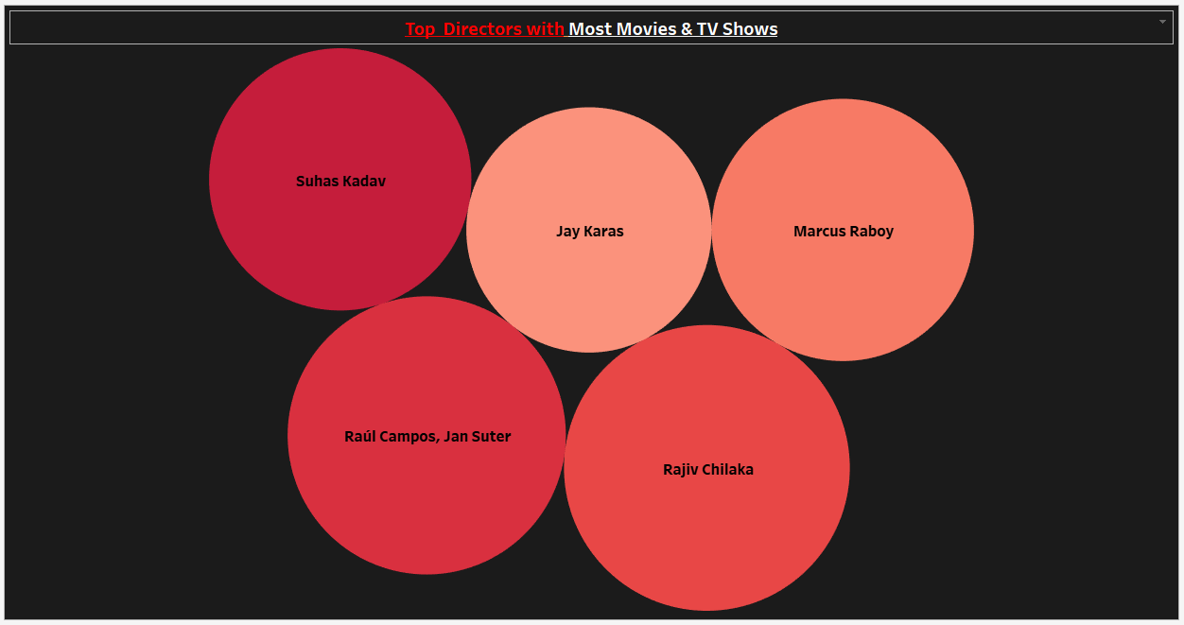
Top Directors with Most Movies & TV Shows
CONCLUSION: These are top Directors Suhas Kadav , Jay karas , Rajiv Chilaka ,Marcus.

Slide 6
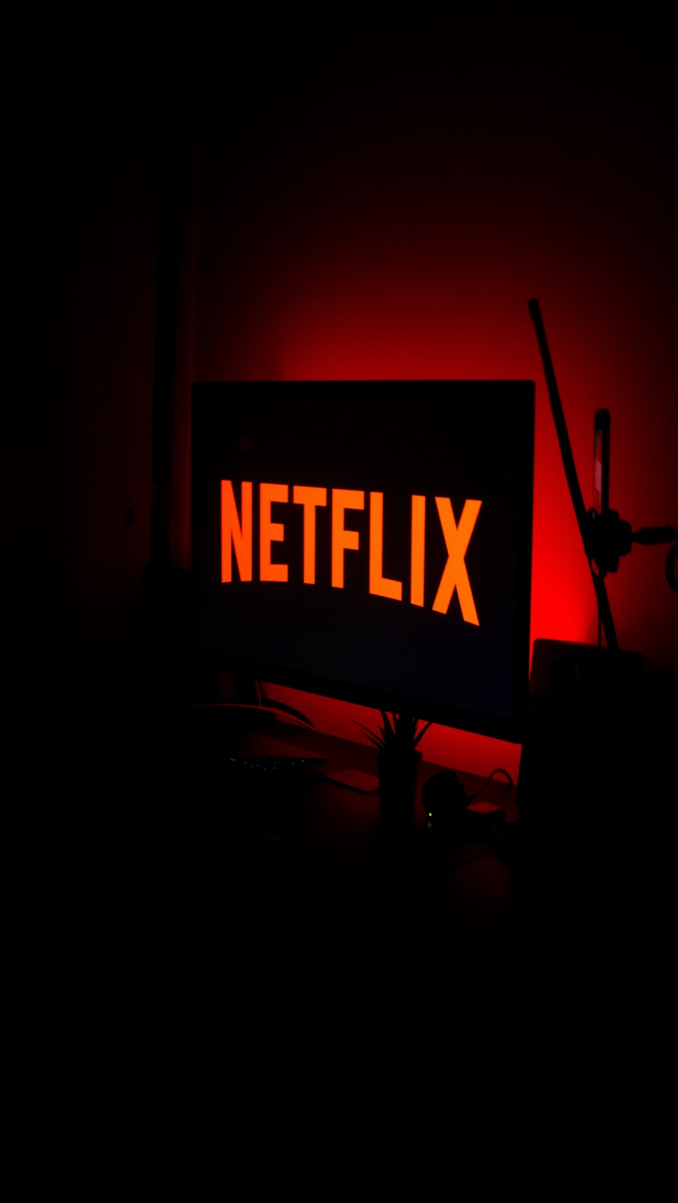
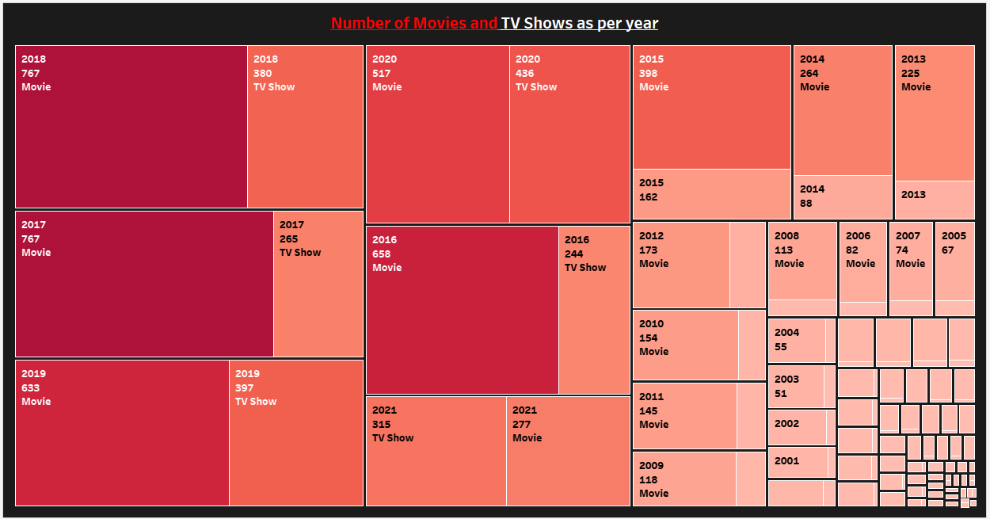
Number of Movies and TV Shows as per year
CONCLUSION: Number of movies and TVs shows as per year, in 2017
around 767 movies released and In 2018 also 767 movies released in 2019
653 Movies released.

Slide 7

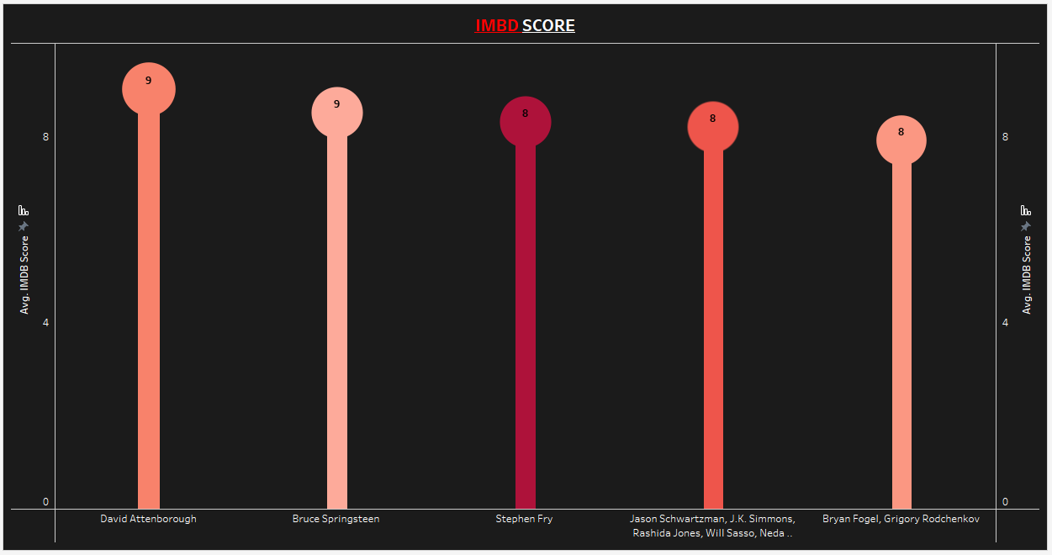
Average IMBD Score as per the Actors
CONCLUSION: IMBD score as per the actors,
David ,Bruce, Stephen, Jasen ,Scarlett.

Slide 8

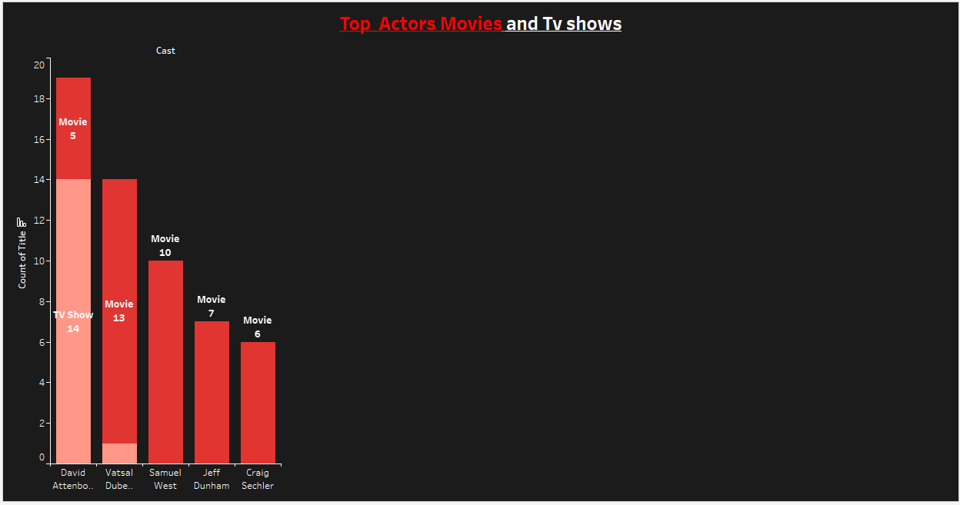
Top Actors Movies and Tv shows
CONCLUSION: Top Actors Movies and TV Shows,
David with 14 TV shows and 5 Movies, Vatsal 1 TV shows and 13 Movies,
Samuel only done 10 movies, jeff with 7 movies, craig with 6 movies.

Slide 9
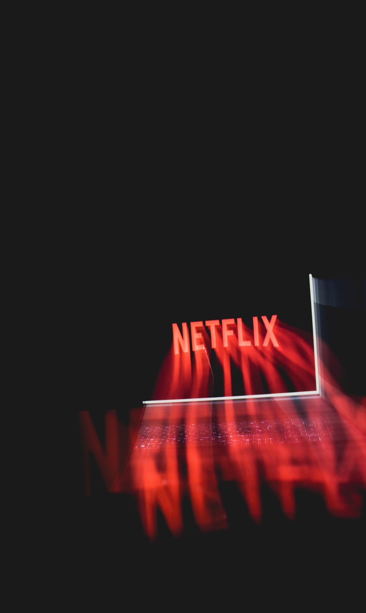
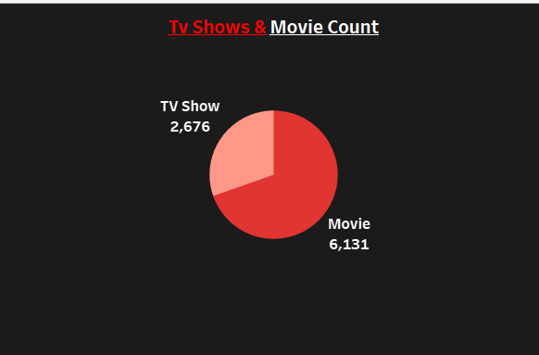
CONCLUSION: Total TV shows Till Date is 2676 and Total Movies 6131
till date.

Slide 10
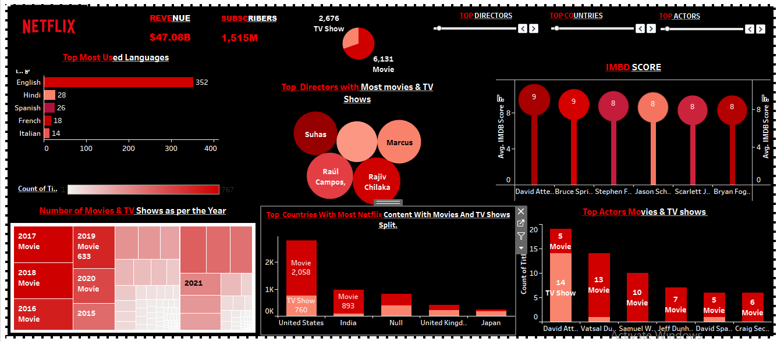
DASHBOARD

Slide 11
Conclusion
Distribution of subscribers and revenue.
We get to know the total number of Movies, Tv shows, Total count of Netflix titles, subscribers & Revenue with the most contribution among countries with the most language used.
Also we were able to find out the top movies with their IMBD ratings, also the directors and actors, with their year of the premier.
Movies & Tv shows added over the months and years.
The project focuses on how Netflix has remained the top choice for TV and movie streaming by keeping its competitive strategy.

Slide 12

THANK-YOU
BY
Ritu Ghansela

